Slide 1


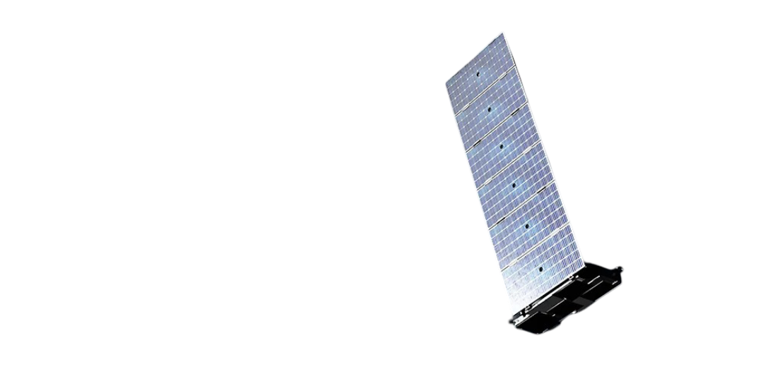
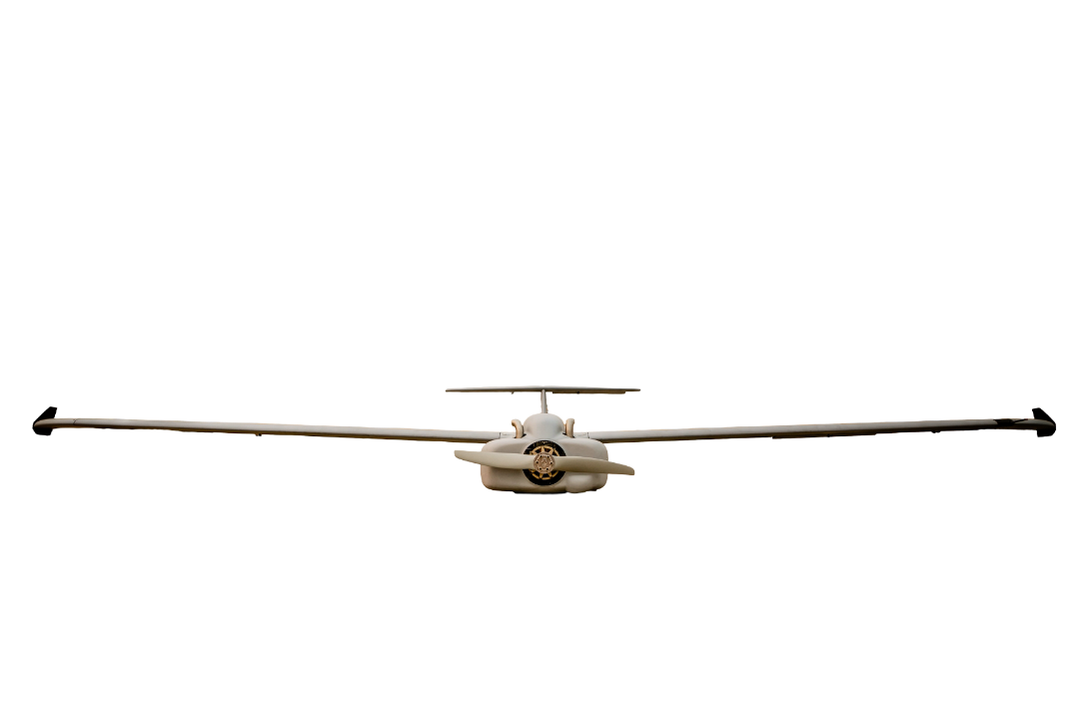
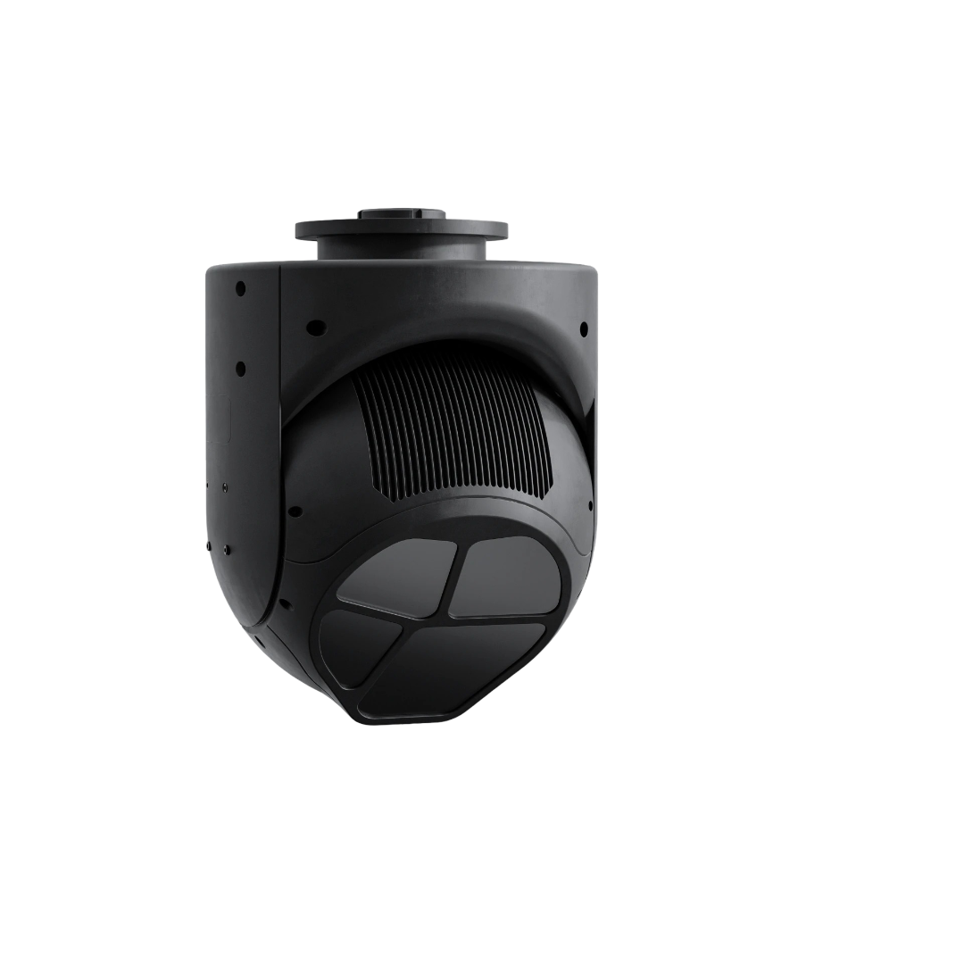
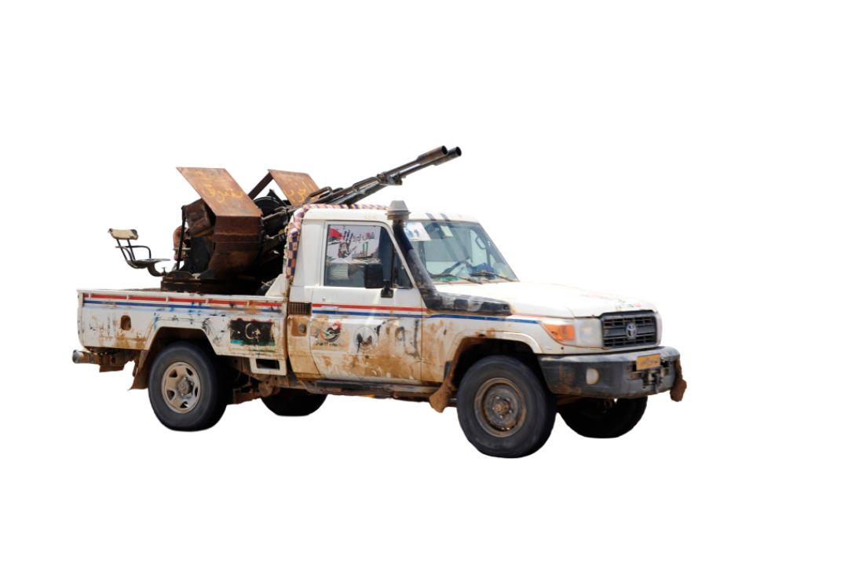
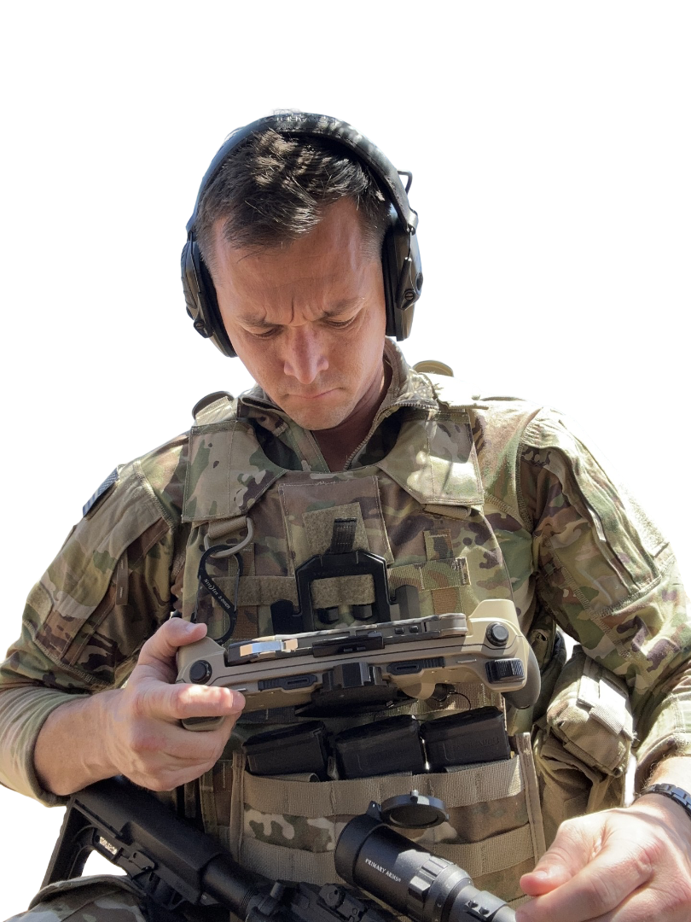
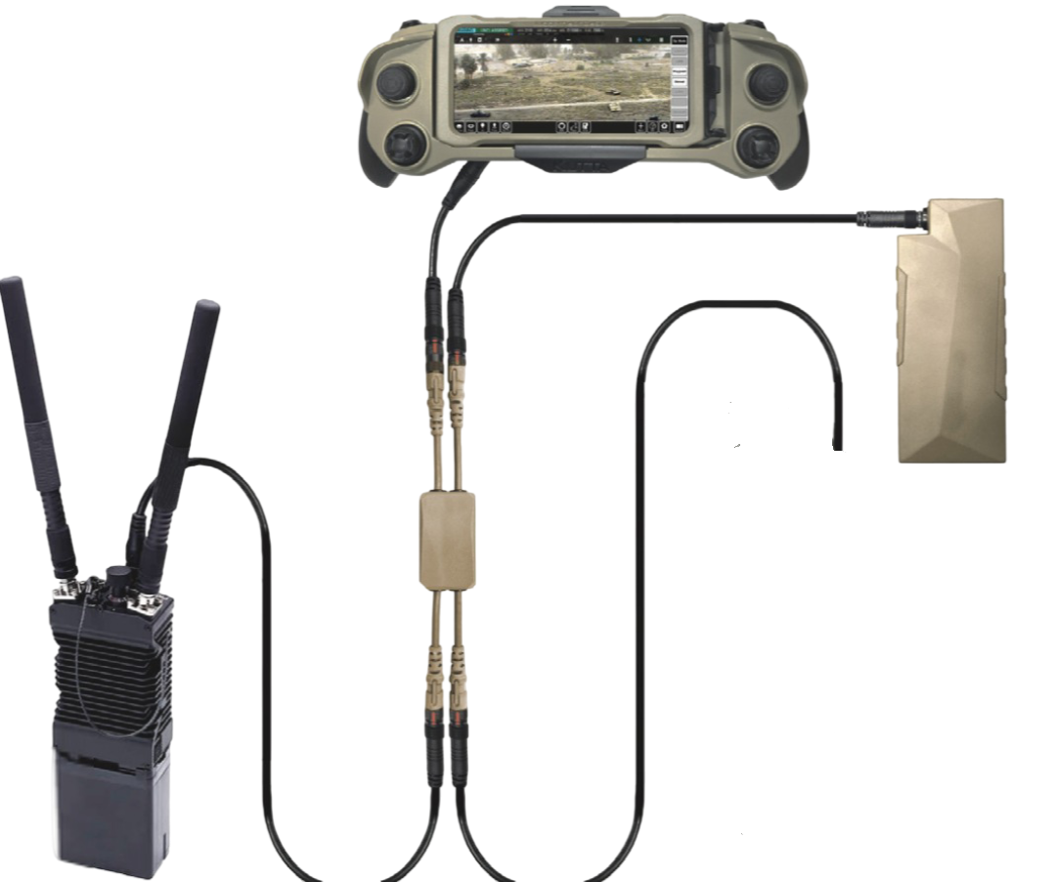
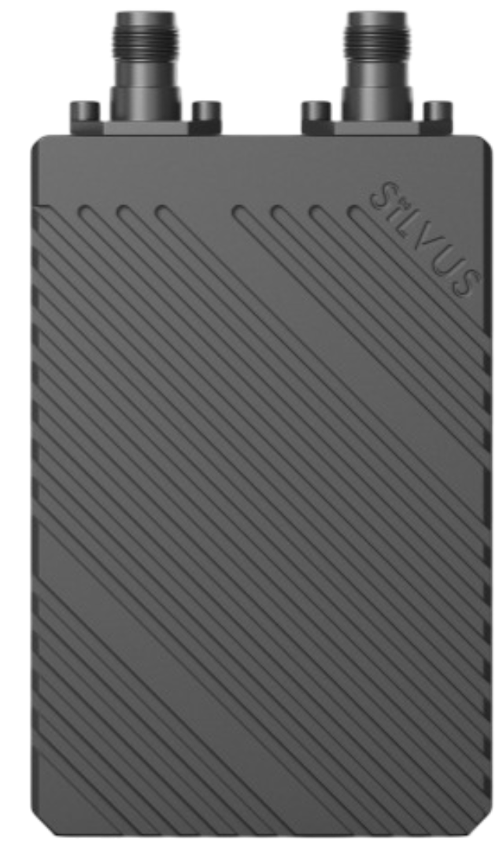
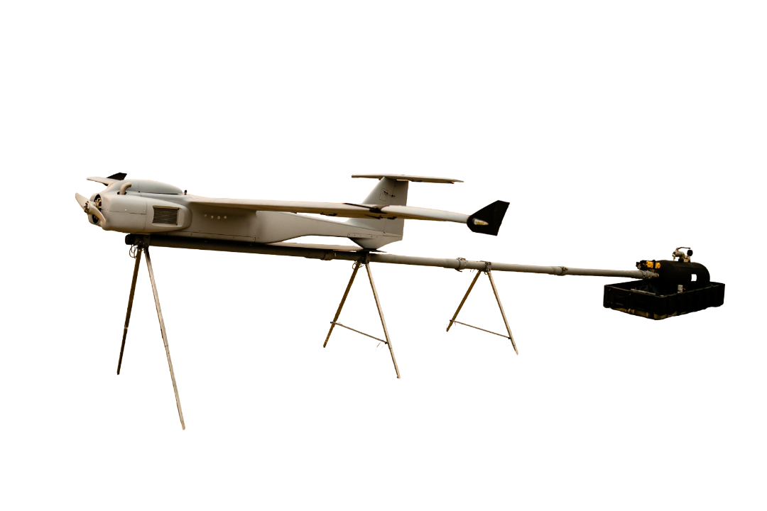

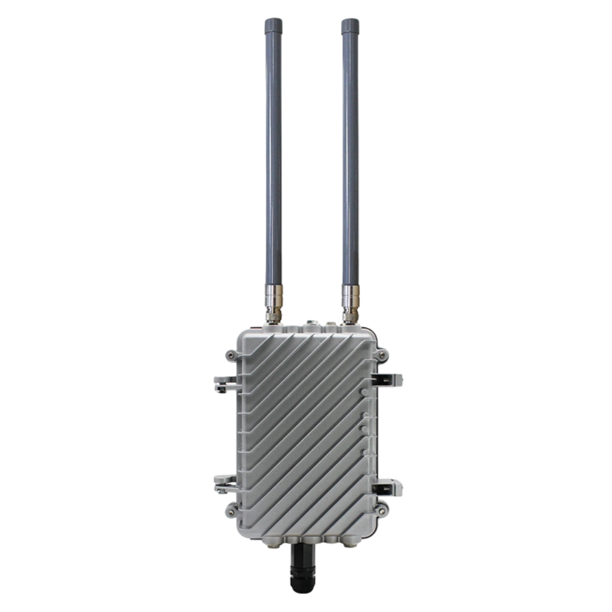


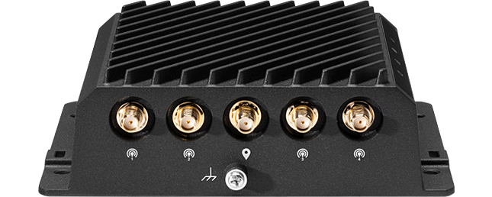
Architecture & Integration
MOSA design
2,000 W external power
Multi-fuel engine
Payload Ecosystem
ARKEUS HSOR – Multispectral ISR
NSP-3 / NSP-5 – SAR | GMTI | MMTI | CCD
Sentient Vision Systems – Air, sea & land
Trillium EO/IR – AIM maritime and ISR tracking
HoodTech EO/IR – Air, sea & land ISR support
Command & Control
Primary: pLEO SATCOM — 20 ms latency, encrypted, web-viewable payload feed
Backup: Silvus SC-4400 — RoIP & LOI3 link redundancy
Silvus SC4200EP 10W LOI3, RoIP with C2 and team Wifi Hotspot ~3KM capable through S23 and KTAK
Silvus SM5200
3km Wi-Fi booster Satellite internet to ground forces
Minimal C2 & GSE

